Slide 1

Stroke Prediction
Preprocessing, Feature Selection and engineering
Visualisation
Decision Tree and Random Forest

Slide 2
PROBLEM STATEMENT
Based on the available information we will predict whether the person will have stroke or not.
Dataset:https://www.kaggle.com/datasets/fedesoriano/stroke-prediction-dataset
This dataset is used to predict whether a patient is likely to get stroke based on the input parameters like gender, age, various diseases, and smoking status. Each row in the data provides relevant information about the patient.

Slide 3
CONTENTS
VIsualisation
EDA and statistics
Training models

Slide 4
Feature Selection
Id is not necessary for the prediction. So we can drop the id attribute from the dataset. Other all features(attributes are important).
Check for the null values in any of the attributes and fill the values with the mean or mode or median.
In our dataset, there are more null values in the bmi feature. By checking for the outliers using IQR(Inter Quartile Range) we found that there are outliers. The bmi values which are less Q1-1.5*IQR or greater than Q3+1.5*IQR.
We filled the null values of bmi attribute with median of the features. When there are outliers median is most suitable then mean for filling up the null values.
We need two techniques named StandardScaling and OverSampling
Since our Dataset is highly undersampled (based on target instances) we are going to perform a over sampling method to have equal representation of both the target classes
Feature scaling is a method used to normalize the range of independent variables or features of data. In data processing, it is also known as data normalization and is generally performed during the data preprocessing step.
Feature Engineering and Preprocessing

Slide 5
One Hot Encoding
Since our dataset contains categorical data, we transformed these categorical data into a binary vector representation that can used as input for models.
Gender attribute contains categorical data so after one hot encoding it was replaced by gender_male_1 if value is 1 indicates male 0 indicates female.
Work_type, Residence ,Smoking_status are also contains categorical data, So we make those dummies.

Slide 6
VISUALISATION
Gender
Inference: There are more females having less probability of getting stroke.
COUNT Female – 2994
Male – 2115
Other – 1
We have a ‘other’ gender and since there is only 1 instance we will remove it. There are more females as compared to males

Slide 7
Hypertension
Inference: Probability of getting stroke is more for people having hypertension than people not having hypertension.
Counts
0: 4611
1: 498

Slide 8
Work_type
Private 2925
Self-employed 819
children 687
Govt_job 657
Never_worked 22
Inference: The majority of the people who got stroke are private workers.

Slide 9
Smoking_status
Counts
never smoked 1892
Unknown 1544
formerly smoked 885
smokes 789
Inference: Based on the plot we can that those who formerly smoked got more strokes The people who smoked and never smoked has a somewhat same probability of getting stroke

Slide 10
Residence_type
Inference: Based on the analysis the people who live in Urban areas were reported with more strokes
Counts
Urban 2596
Rural 2513
We have almost equal percentage of people from urban and rural.

Slide 11
Age
Since it is not categorical data, we used histogram to find the age of majority people.
Inference: It follows normal distribution
There are no outliers according to the box plot.

Slide 12
BMI
Continuous data, so we can visualise using the histogram.
Inference: Based on the histogram and boxplot we see that there are many outliers in bmi.

Slide 13
Null values – 201
NULL values hold 3.93 % of the instances in the dataframe.
The distribution is right skewed with skewness 1.05
People who got stroke and their BMI is NA: 40
People who got stroke and their BMI is given: 249
Percentage of people with stroke in Nan values to the overall dataset: 16.04
Among the 201 bmi NULL values 40 values in them got stroke
Thus we cant drop NULL values
Since there are outliers present we can’t perform mean imputation as mean is affected
by the outliers
Hence we impute it with median values
Median of the values:28.1

Slide 14
Ever_married
Inference: This plotting shows that the number of "Married people with Strokes" is approximately 10 to 12 times the no. "Unmarried people with Strokes".
This shows most of the Married people got Strokes compared to Unmarried people.

Slide 15
Heart_disease
Inference:This plotting shows that the number of "people with Strokes but no heart disease" is approximately 6 to 8 times the number of "people with Strokes and also heart disease". This shows most of the people with no heart disease are suffering with Strokes compared to the once who have Heart Disease.

Slide 16
Average_glucose_level
Inference: There are many outliers present based on the boxplot and histogram

Slide 17
Correlation between the attributes

Slide 18
There is a weak correlation between the attributes as per the plotted heatmap
The highest correlation found was between age and bmi - 0.32
Rest all correlations were less than 0.32
We could not draw any statistical insight from heatmap
OVERSAMPLING
Since our Dataset is highly undersampled (based on target instances) we are going to perform a over sampling method to have equal representation of both the target classes
# Using random oversampling - importing the library
SCALING
Since the numeric attributes in the dataset is in different ranges and three are outliers present we are using a scaler to get all the values into the same range.
SPITTING THE DATA-
We splitted the data for training and testing purpose using sklearn.select_model library

Slide 19
MODEL 1 – DECISION TREE
Decision Tree is a Supervised learning technique that can be used for both classification and Regression problems, but mostly it is preferred for solving Classification problems
●It is a tree-structured classifier, where
internal nodes represent the features of a dataset
branches represent the decision rules
each leaf node represents the outcome
Preprocessed data is splitted into X_train,x_test,y_train,y_test and then fitted into the model.
Decision Tree can be impelemented by DecisionTreeClassifier from sklearn.tree
For user input based on the format of one hot encoded dataframe the input is appended on the x_train and then x_test is predicted using the predict function.

Slide 20
# Import the Decision Tree Classifier module
from sklearn.tree import DecisionTreeClassifier
# Libraries for calculating performance metrics
from sklearn import metrics
import numpy as np
from sklearn.metrics import auc, roc_auc_score, roc_curve, precision_score, recall_score, f1_score, accuracy_score
import pandas as pd
# Create the classifier
objectclf = DecisionTreeClassifier()
# Training the classifier
clf = clf.fit(X_train, y_train)
# Define a function to get user input
def get_user_input():
# Get input from user
print(df.columns)
user_input = input("Please enter your data in the given format: ") # Convert user input to a list use = user_input.split() # Create a pandas series from the user input
user_data = pd.Series(use, index=X_test.columns) # Append the user data to the test dataset gg= X_test.append(user_data, ignore_index=True) #print(y_test) # Return the last row of the test dataset print(gg.tail(1))
return gg.tail(1)# Get user data
u = get_user_input()# Predict result using the user's datay = clf.predict(u)
y_test.append(pd.Series(y),ignore_index=True)# Print the prediction.print("The predicted output is:", "STORKE" if y==1 else "NO STROKE")y_pred=clf.predict(X_test)p

Slide 21
VISUALISATION can be done using tree.plot_tree

Slide 22
METRICS:
Accuracy: 0.97
Precision: 0.94
Recall: 1.00
F1 Score: 0.97
ROC AUC Score: 0.97
Confusion Matrix:
[[1851 117]
[0 1920]]
accuracy = accuracy_score(y_test, y_pred)
precision = precision_score(y_test, y_pred)
recall = recall_score(y_test, y_pred)
f1 = f1_score(y_test, y_pred)
roc_auc = roc_auc_score(y_test, clf.predict_proba(X_test)[:, 1])
# Print the metrics
print(f"Accuracy: {accuracy:.2f}")
print(f"Precision: {precision:.2f}")
print(f"Recall: {recall:.2f}")
print(f"F1 Score: {f1:.2f}")
print(f"ROC AUC Score: {roc_auc:.2f}")
print("Confusion Matrix: ")
print(confusion_matrix(y_test,y_pred))

Slide 23
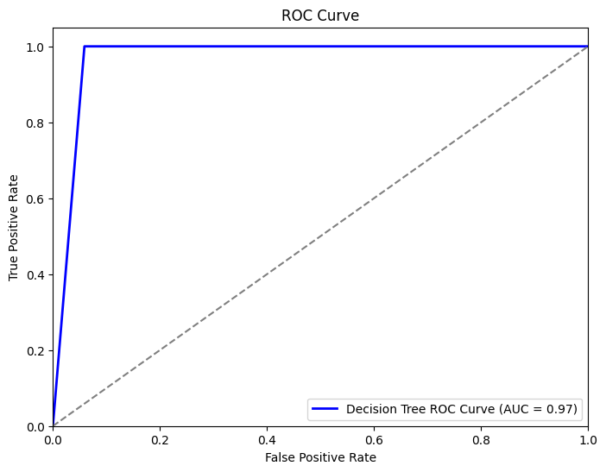
ROC AUC CURVE:
An ROC curve plots TPR vs. FPR at different classification thresholds. Lowering the classification threshold classifies more items as positive, thus increasing both False Positives and True Positives. The following figure shows a typical ROC curve.

Slide 24
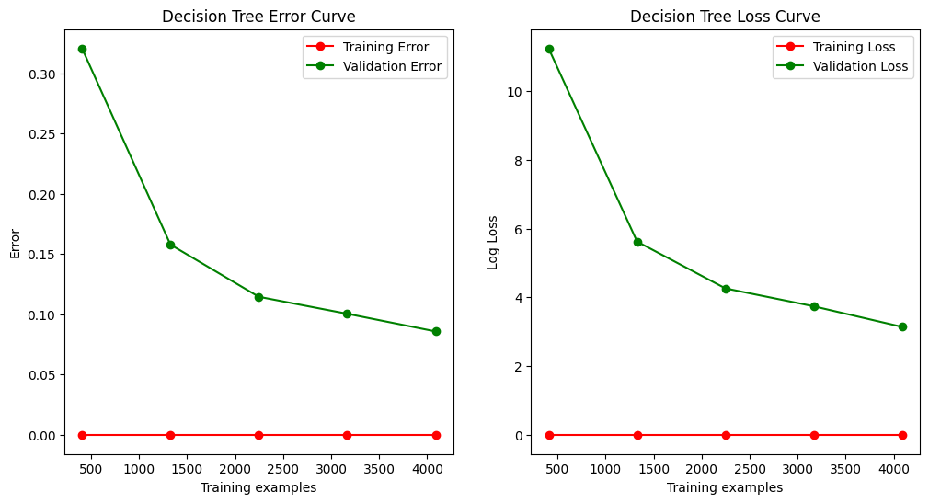
Error and Loss Curves:

Slide 25
MODEL 2 – RANDOM FOREST
Random Forest is a classifier that contains a number of decision trees on
various subsets of the given dataset and takes the average to improve the
predictive accuracy of that dataset.
1.
Random subsets are created from the original dataset (bootstrapping).
2.
At each node in the decision tree, only a random set of features are
considered to decide the best split.
3.
A decision tree model is fitted on each of the subsets.
4.
The final prediction is calculated by averaging the predictions from
all decision trees.

Slide 26
from sklearn.ensemble import RandomForestClassifier
# Create the classifier object
rf_clf = RandomForestClassifier(n_estimators = 10)
# Train the model using the training sets
rf_clf.fit(X_train, y_train)
# performing predictions on the test dataset
y_pred_rf = rf_clf.predict(X_test)
# Define a function to get user input
def get_user_input():
# Get input from user
print(df.columns)
user_input = input("Please enter your data in the given format: ")
# Convert user input to a list
use = user_input.split()
# Create a pandas series from the user input
user_data = pd.Series(use, index=X_test.columns)

Slide 27
# Append the user data to the test dataset
gg= X_test.append(user_data, ignore_index=True)
# Return the last row of the test dataset
print(gg.tail(1))
return gg.tail(1)
# Get user data
u = get_user_input()
# Predict result using the user's data
y = clf.predict(u)
# Print the prediction.
print("The predicted output is:", y)

Slide 28
METRICS:
Accuracy: 0.97
Precision: 0.94
Recall: 1.00
F1 Score: 0.97
ROC AUC Score: 0.97
Confusion Matrix:
[[1913 55]
[0 1920]]
accuracy = accuracy_score(y_test, y_pred_rf)
precision = precision_score(y_test, y_pred_rf)
recall = recall_score(y_test, y_pred_rf)
f1 = f1_score(y_test, y_pred_rf)
roc_auc = roc_auc_score(y_test, rf_clf.predict_proba(X_test)[:, 1])
# Print the metrics
print(f"Accuracy: {accuracy:.2f}")
print(f"Precision: {precision:.2f}")
print(f"Recall: {recall:.2f}")
print(f"F1 Score: {f1:.2f}")
print(f"ROC AUC Score: {roc_auc:.2f}")
print(confusion_matrix(y_test,y_pred_rf))

Slide 29
ROC CURVE :
ERROR AND LOSS CURVES

Slide 30
MODEL 3 - KNN
KNN (K-Nearest Neighbors) is a supervised machine learning algorithm that can be used for classification and regression tasks. It is a non-parametric algorithm, which means that it does not make any assumptions about the underlying distribution of the data. In the context of stroke prediction, KNN can be used to classify patients as being at high or low risk of stroke based on their medical history and other factors.

Slide 31
IMPLEMENTATION OF KNN
#importing the necessary libraries
from sklearn.neighbors import KNeighborsClassifier
from sklearn.metrics import classification_report,accuracy_score,confusion_matrix
from sklearn.metrics import auc,roc_auc_score,roc_curve,precision_score,recall_score,f1_score
import matplotlib.pyplot as plt
import seaborn as sns
import pandas as pd
import numpy as np
# Create the classifier object
knn = KNeighborsClassifier(n_neighbors = 2)
# Training the classifier
knn.fit(X_train,y_train)
#predicting result using the test dataset
y_pred_knn = knn.predict(X_test)
y_pred_prob_knn = knn.predict_proba(X_test)[:, 1]

Slide 32
VISUALISATION AND METRICS
# Plot the confusion matrix big and with colors
def plot_confusion_matrix(y_true, y_pred, classes, cmap=plt.cm.Blues):
cm = confusion_matrix(y_true, y_pred)
fig, ax = plt.subplots(figsize=(10, 10))
sns.heatmap(cm, annot=True, fmt=".3f", ax=ax, cmap=cmap)
ax.set_title('Confusion Matrix')
ax.set_xlabel('Predicted Labels')
ax.set_ylabel('True Labels')
ax.set_xticklabels(classes)
ax.set_yticklabels(classes)
plt.show()
# Plot the confusion matrix
plot_confusion_matrix(y_test, y_pred_knn, classes=['No Stroke', 'Stroke'], cmap=plt.cm.Blues)
print('Accuracy:',accuracy_score(y_test, y_pred_knn))
print('Precision:', precision_score(y_test, y_pred_knn))
print('Recall:', recall_score(y_test, y_pred_knn))
print('F1 Score:', f1_score(y_test, y_pred_knn))
print('ROC AUC Score:', roc_auc_score(y_test, y_pred_prob_knn))
error_rate = []
accuracy_rate = []

Slide 33
# Will take some time
for i in range(1,40):
knn = KNeighborsClassifier(n_neighbors=i)
knn.fit(X_train,y_train)
pred_i = knn.predict(X_test)
error_rate.append(np.mean(pred_i != y_test))
accuracy_rate.append(accuracy_score(y_test, pred_i))
# Plotting the error and loss curve
plt.figure(figsize=(10,5))
plt.plot(range(1,40), error_rate, color='blue', linestyle='dashed', marker='o', markerfacecolor='red', markersize=10)
plt.title('Error Rate vs. K Value')
plt.xlabel('K')
plt.ylabel('Error Rate')
plt.show()
# Plotting the KNN graph
plt.figure(figsize=(10,5))
plt.plot(range(1,40), accuracy_rate, color='blue', linestyle='dashed', marker='o', markerfacecolor='red', markersize=10)
plt.title('Accuracy Rate vs. K Value')
plt.xlabel('K')
plt.ylabel('Accuracy Rate')
plt.show()

Slide 34
fpr_dt, tpr_dt, thresholds_dt = roc_curve(y_test, y_pred_knn)
# Calculate the ROC AUC score for the Decision Tree model
roc_auc_dt = roc_auc_score(y_test, y_pred_knn)
# P
plt.figure(figsize=(8, 6))
plt.plot(fpr_dt, tpr_dt, color='b', lw=2, label=f'KNN ROC Curve (AUC = {roc_auc_dt:.2f})')
plt.plot([0, 1], [0, 1], color='gray', linestyle='--')
plt.xlim([0.0, 1.0])
plt.ylim([0.0, 1.05])
plt.xlabel('False Positive Rate')
plt.ylabel('True Positive Rate')
plt.title('ROC Curve')
plt.legend(loc='lower right')
plt.show()

Slide 35
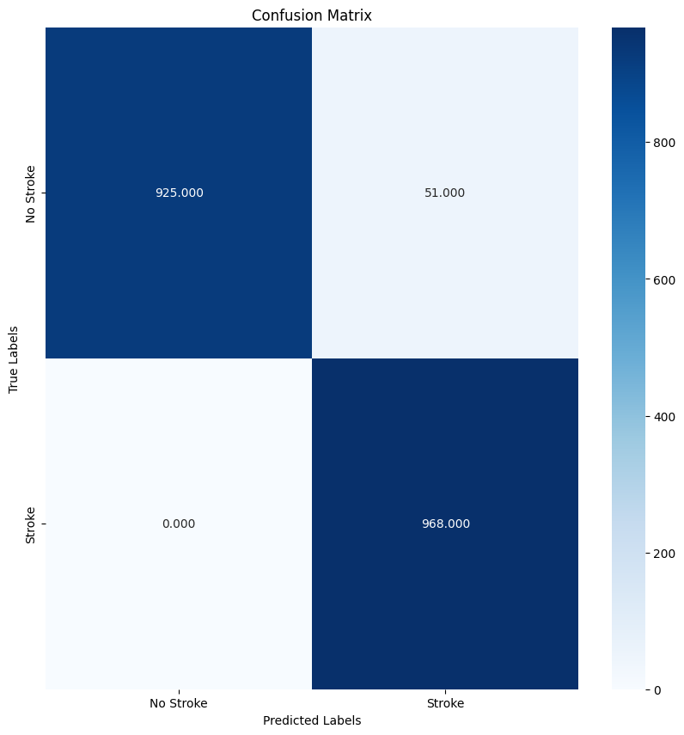

Slide 36
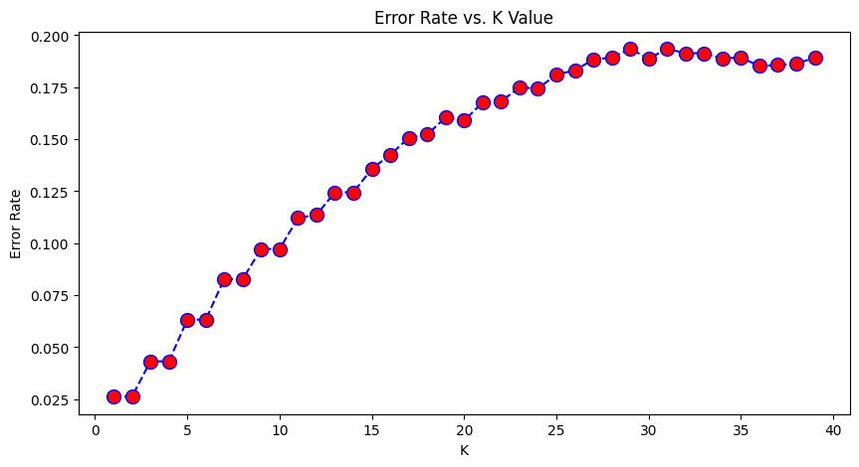

Slide 37
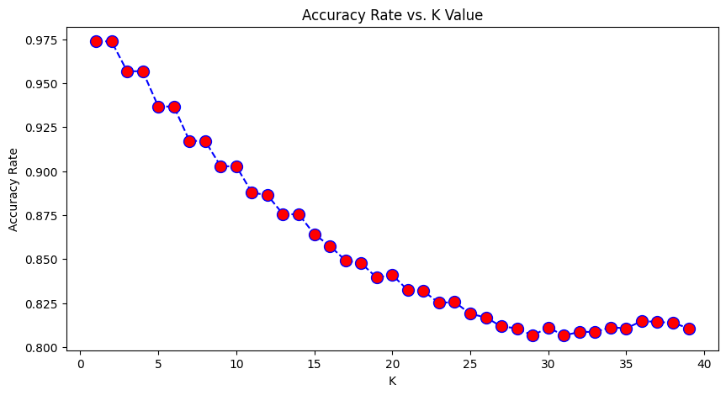

Slide 38
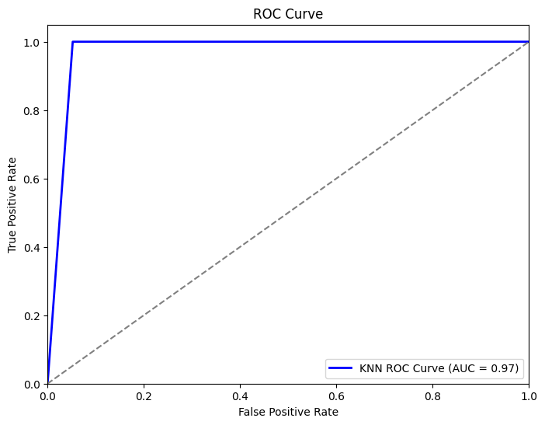

Slide 39
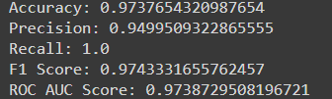

Slide 40
MODEL 4:ARTIFICIAL NEURAL NETWORK(ANN)
EXPLANATION:
Artificial neural networks (ANNs) are a type of machine learning algorithm that is inspired by the structure and function of the human brain. ANNs are made up of interconnected nodes, which are called neurons. Each neuron can perform a simple mathematical operation, such as multiplying two numbers or adding two numbers. ANNs can be trained to perform a wide variety of tasks, including classification, regression, and forecasting.In the context of stroke prediction, ANNs can be used to classify patients as being at high or low risk of stroke based on their medical history and other factors. ANNs are particularly well-suited for this task because they are able to learn complex relationships between the input features and the target variable (i.e., whether or not the patient has a stroke).

Slide 41
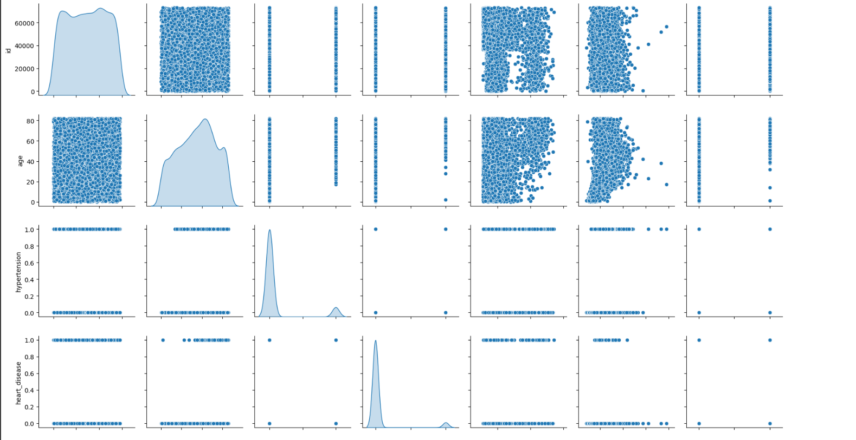
VISUALIZATION:

Slide 42
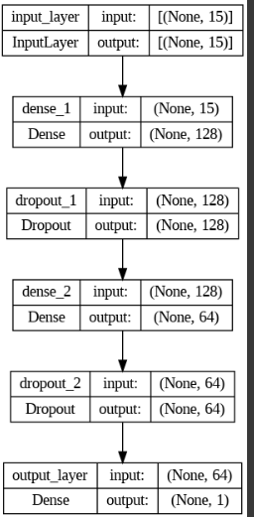
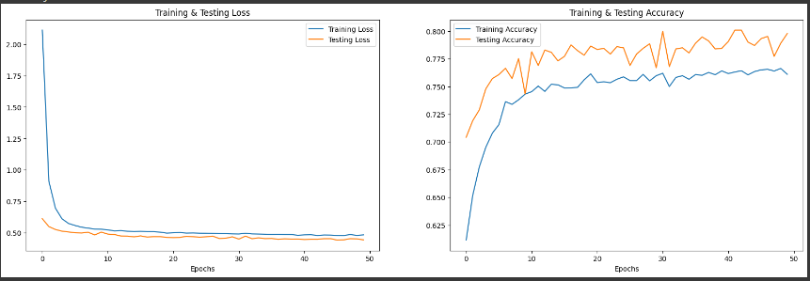

Slide 43
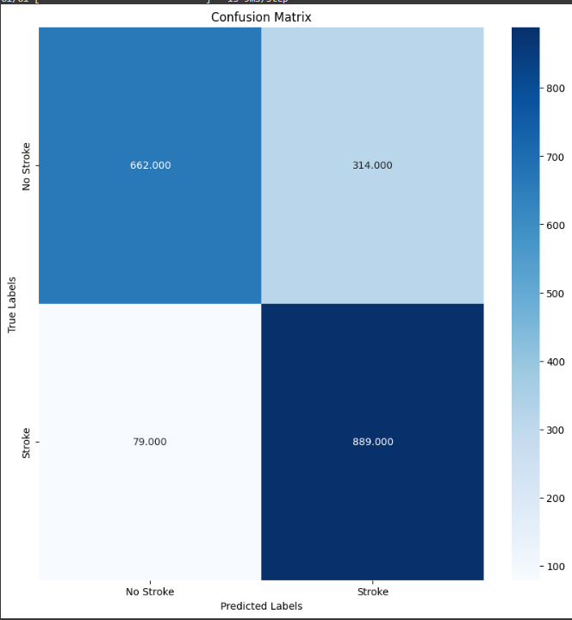
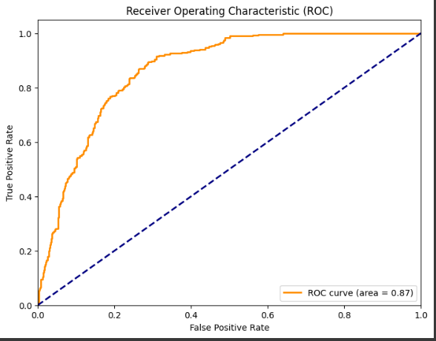

Slide 44
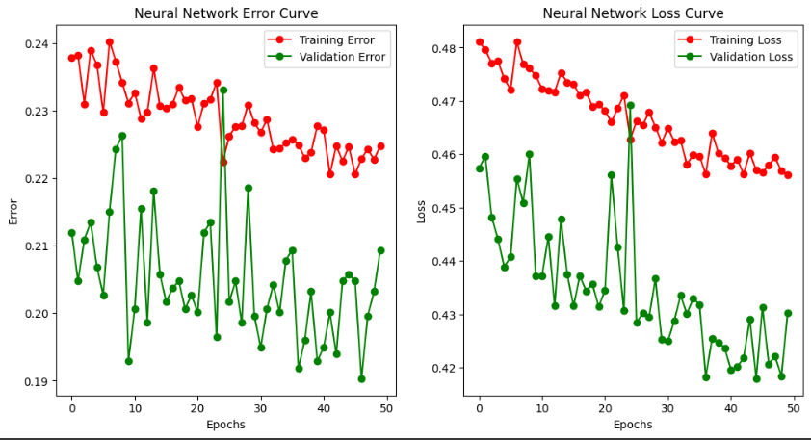

Slide 45
MODEL 5:
LOGISTIC REGRESSION
Logistic regression is a supervised machine learning algorithm that can be used for classification tasks. It is a simple and easy-to-understand algorithm, and it has been shown to be effective for stroke prediction.Overall, logistic regression is a good choice for stroke prediction because it is simple, robust, and efficient. However, it is important to be aware of the potential disadvantages of using logistic regression, such as its lower accuracy and susceptibility to overfitting.

Slide 46
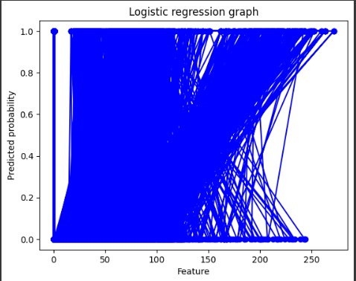
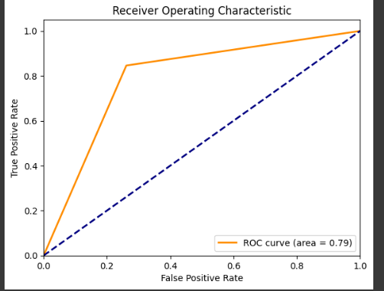
VISUALIZATION:

Slide 47
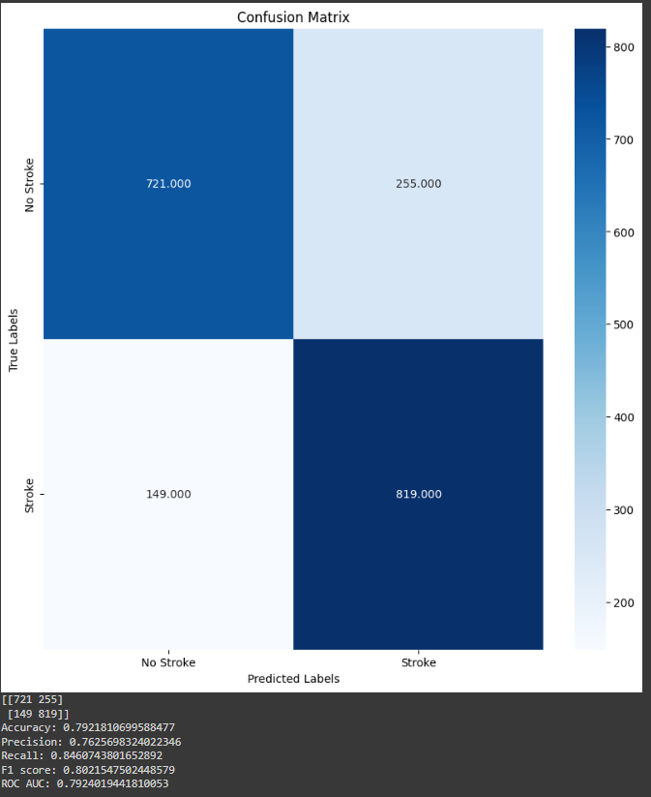

Slide 48
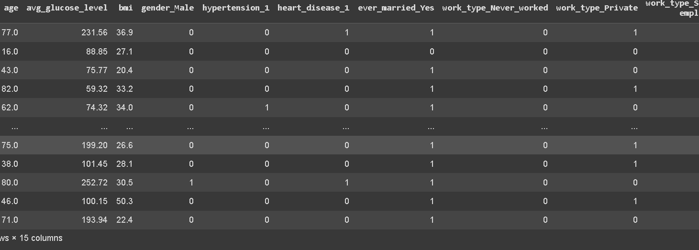
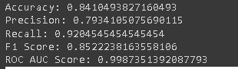
Approach -1 (1 hot encoding)
In this processed and transformed dataset we apply the SVM model library and use rbf (Radial basis function) which we got 84% accuracy.

Slide 49
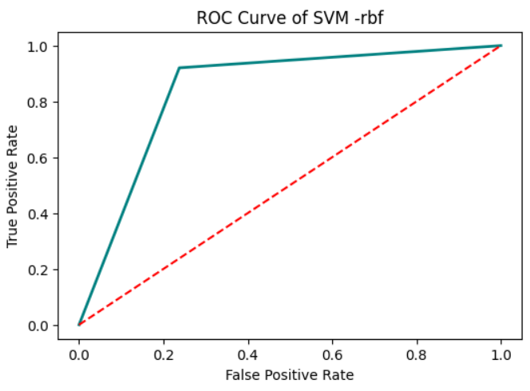
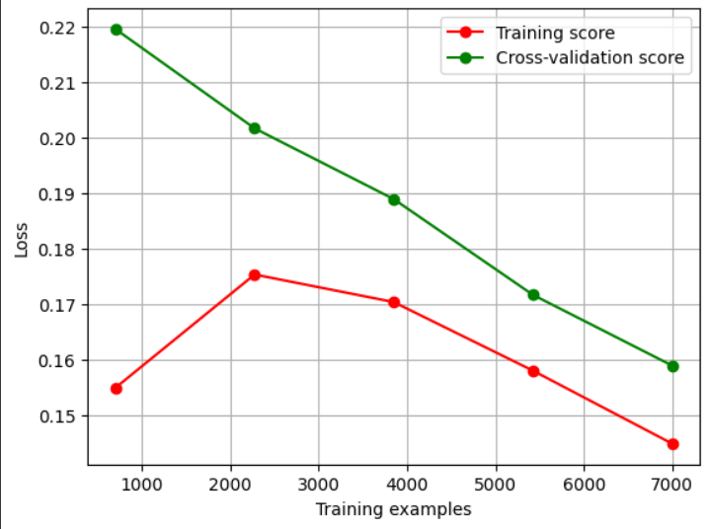
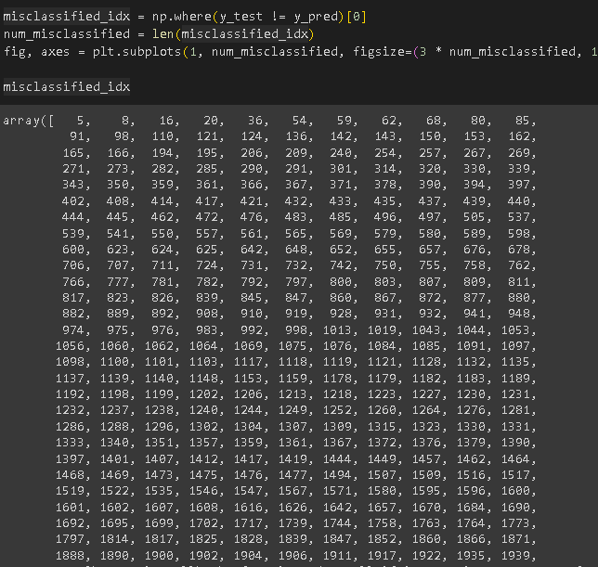
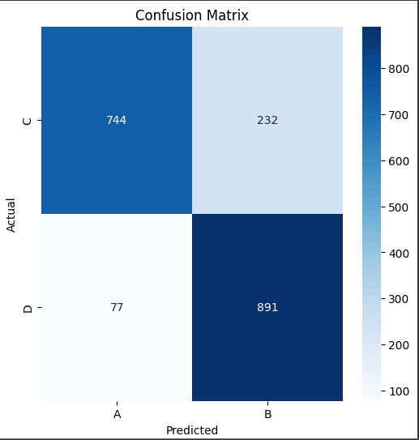

Slide 50
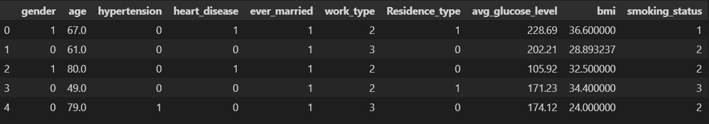
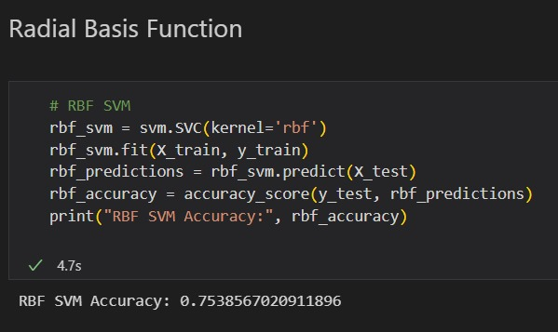
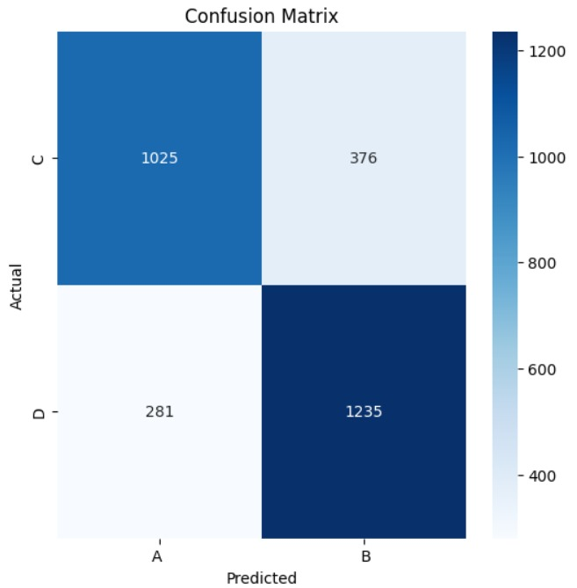
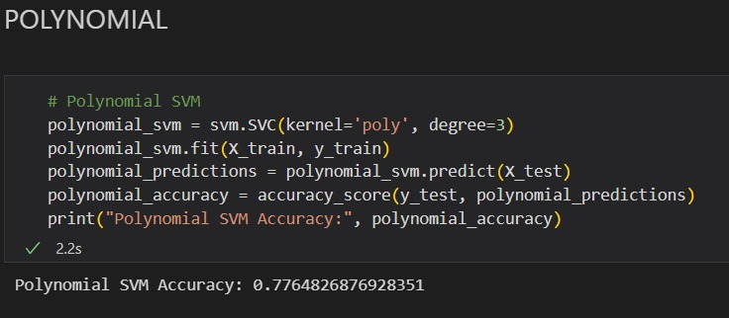
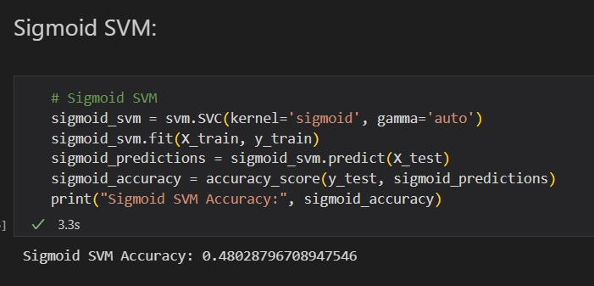
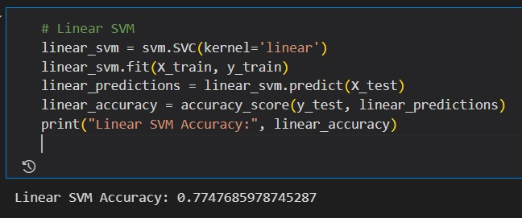
Approach 2 – Linear encoded dataset

Slide 51
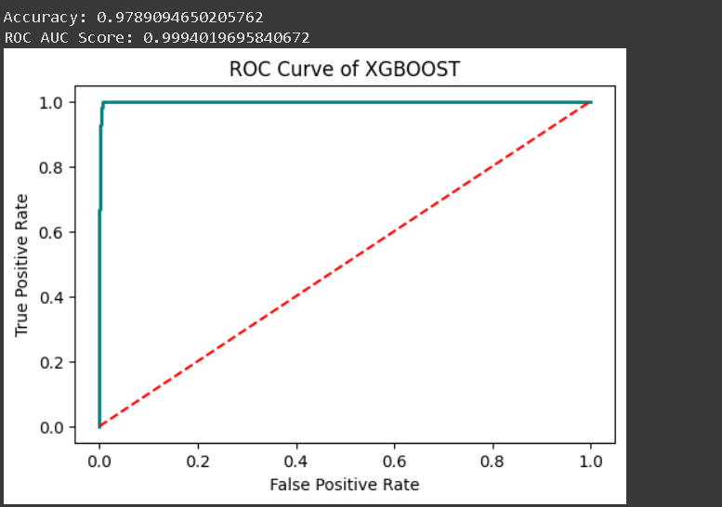
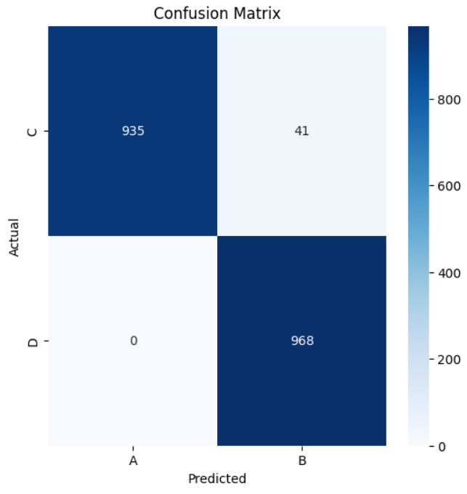
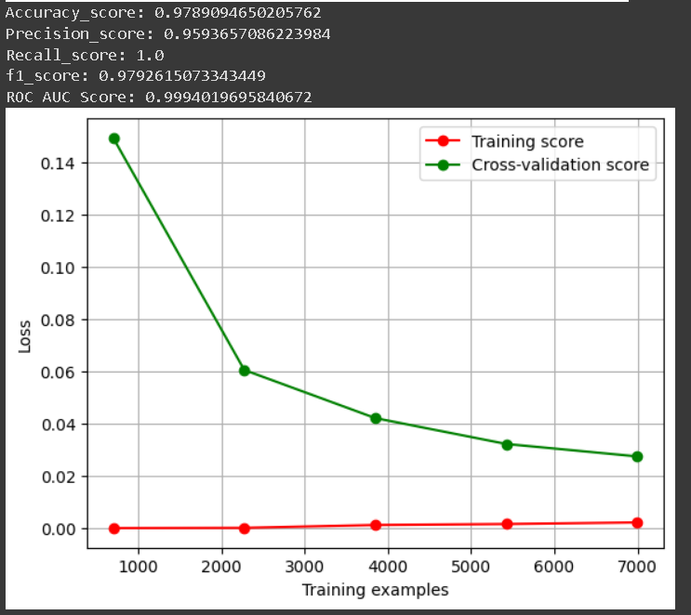
XGBoost
Without Standard Scaling→
Accuracy in both cases is 97.89% which is
Good enough and we found that it wasn’t
Overfitting too which made this model
preferred
With Standard Scaling→

Slide 52
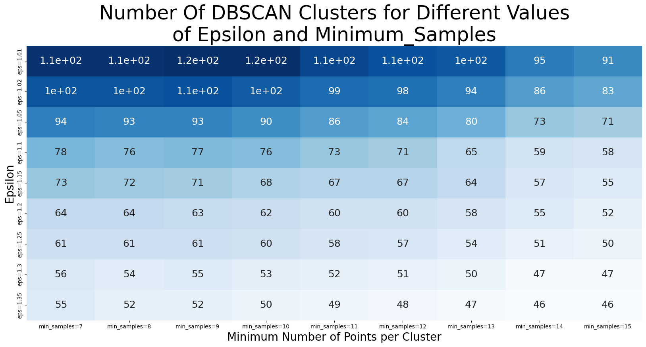
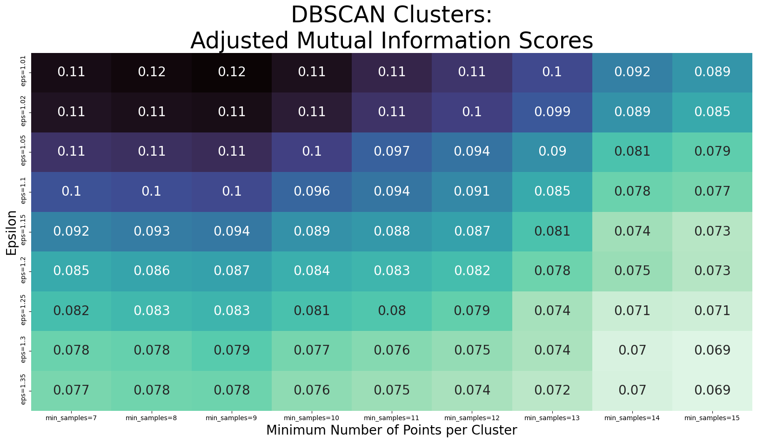
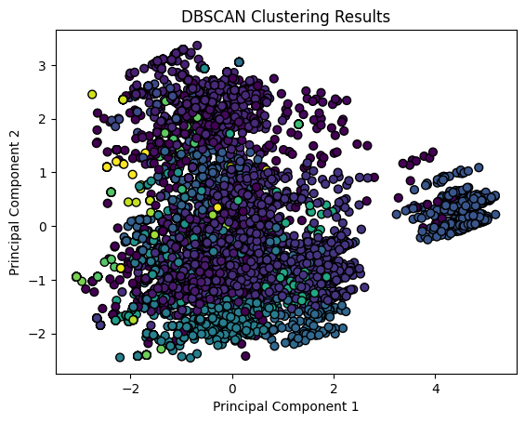
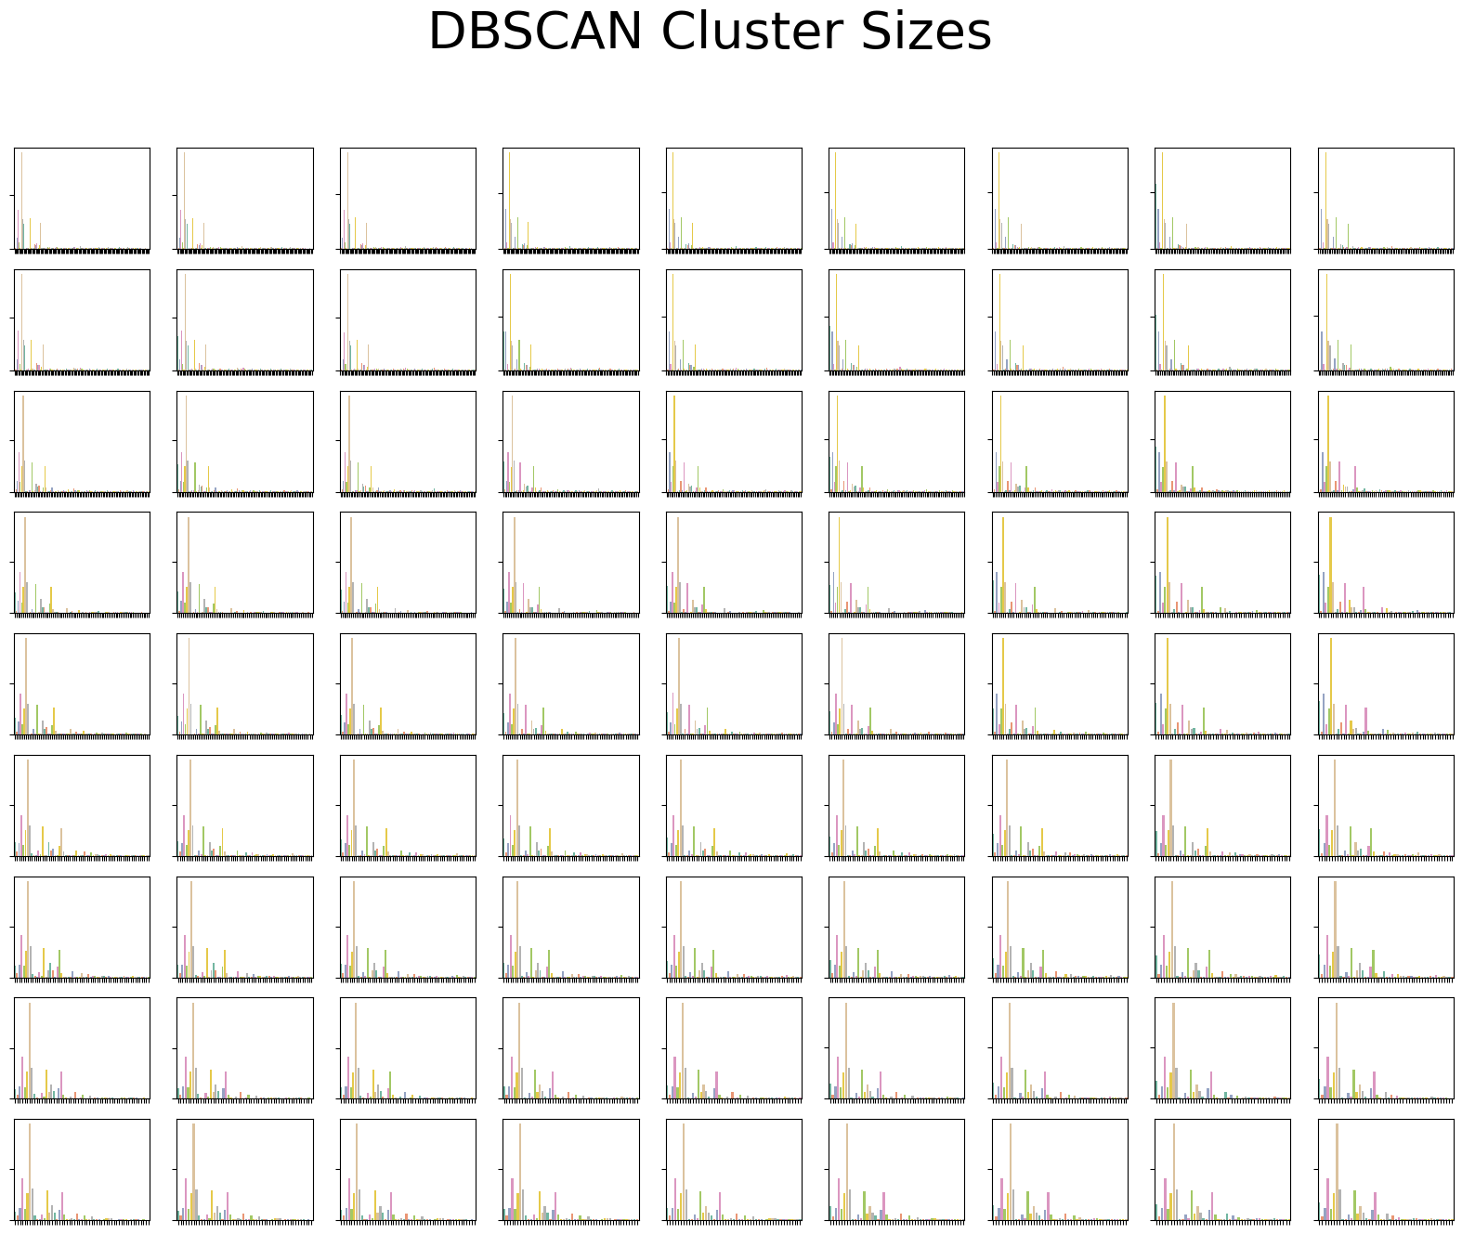
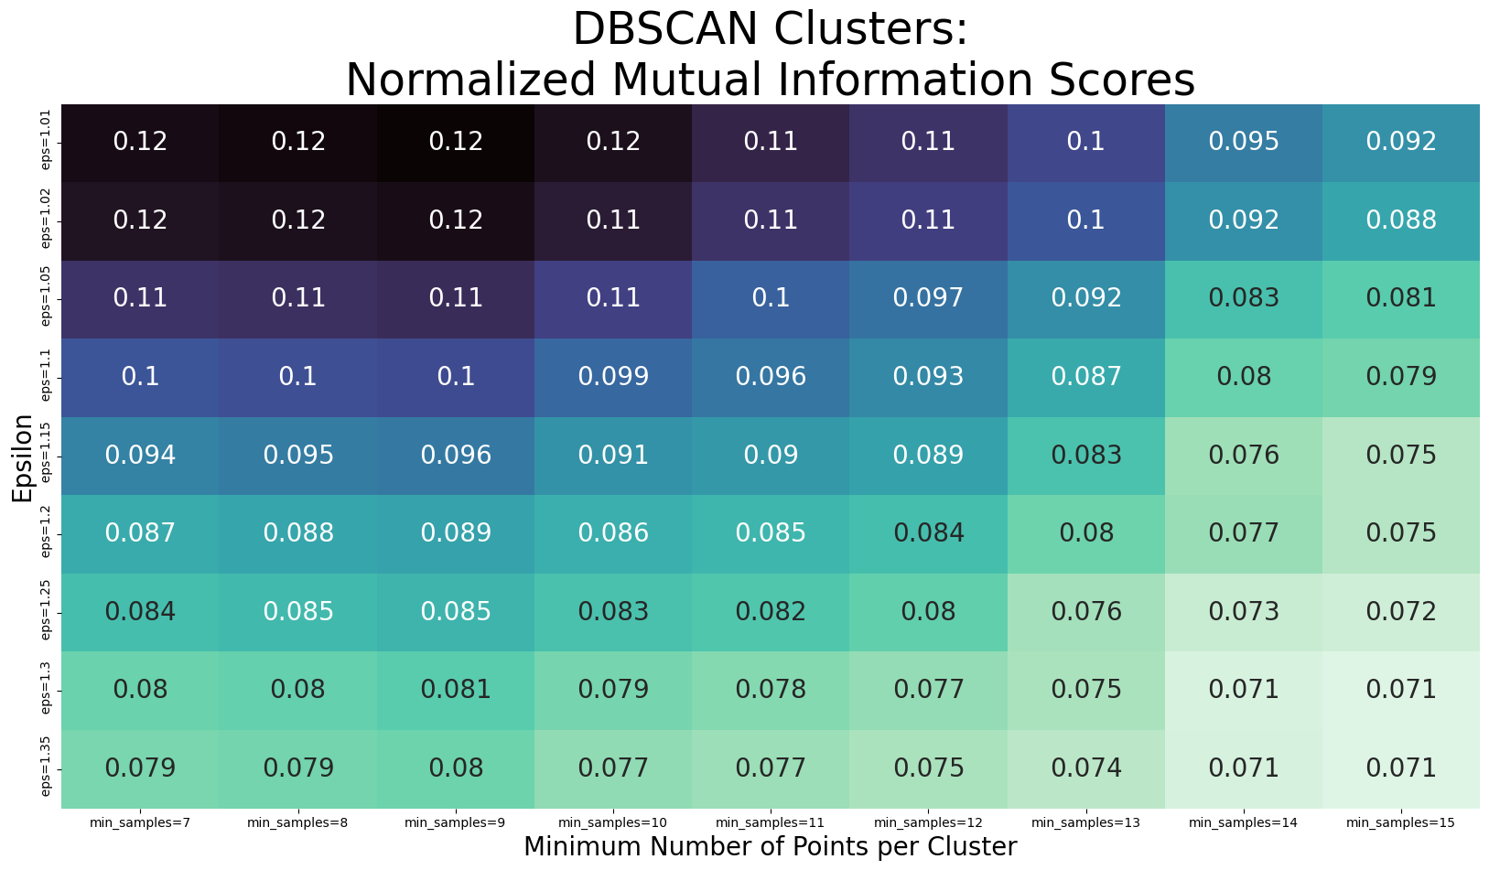
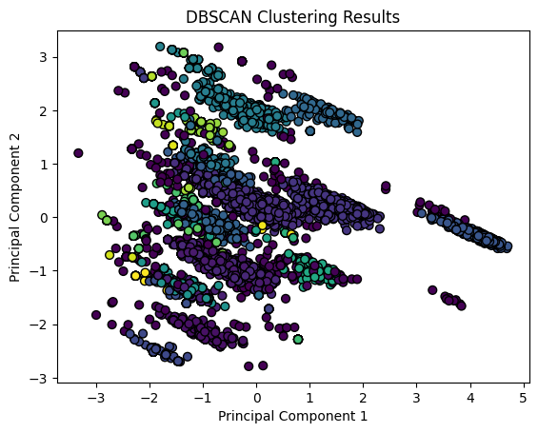
DBSCAN

Slide 53
Thank you

